Slide 1
EAP and MAP Awareness
Communications Refresher Toolkit
Call or email us:
Australia: 1300 307 912
New Zealand: 0800 425 526
International: +61 8 9388 9000
hello@peoplesense.au
PeopleSense - Psychology and Wellbeing by Altius

Slide 2
Acknowledgement of Country
Altius acknowledge the traditional custodians of country throughout Australia and recognise their continuing connection to land, waters and community. ​We pay our respects to their cultures; and to Elders, both past and present.

Slide 3
EAP and MAP Awareness | Communication Refresher Toolkit
This resource pack is designed to make it easy for you to remind employees and leaders about the support available through your existing Employee Assistance Program (EAP). It includes ready-to-use communication templates and promotional assets to help keep your EAP visible, encourage appropriate use, and reinforce the confidential support available to employees and leaders throughout the year.
What’s included:
Employee EAP reminder emails – ready-to-use copy to remind employees how our EAP can support them when they need someone independent and qualified to talk things through with.
Leader MAP reminder email – ready-to-use copy to remind leaders about the Manager Assistance Program (MAP) and the confidential guidance available for real management moments.
Intranet social post – ready-to-use internal social posts to reinforce the launch messaging and share them across relevant platforms during launch.
Wellbeing Webinar emails – ready-to-use copy to promote the upcoming FREE Wellbeing Webinars in 2026.
Please note: Supporting promotional materials have been linked throughout this document. However, some assets must be downloaded directly from AltiusLife to ensure your organisation’s unique booking code is included.
No AltiusLife portal access? please email info@altiuslife.com.au

Slide 4
All Team Members Reminder
Email Template #1:
EAP Reminder
Email Subject: Reminder: Our EAP is available when you need support
Hi Team,
Just a reminder that our Employee Assistance Program (EAP) is available to you whenever you need extra support. At different times, things can feel overwhelming; whether it’s work-related or personal. You might speak with friends or colleagues or try to manage it on your own. But sometimes it helps to talk to someone independent who’s trained to listen and guide you through it.
That’s where our EAP comes in. Delivered by PeopleSense: Psychology & Wellbeing by Altius, the program gives you access to qualified professionals who can provide confidential, support. EAP can be used for a wide range of reasons, including:
      Stress or anxiety
      Work or Life changes and challenges
      Relationship or family pressures
      Grief or loss
      Building confidence, or simply needing someone to talk to
Sessions are available by phone, video, or in person, depending on what works best for you.
✅ Free to access ✅ Completely confidential ✅ Available when you need it
How to access the EAP:
Visit: [Insert your PeopleSense booking link]
Registration code: [Insert code]
You can also watch a short video explaining how PeopleSense’s EAP works. Taking the first step can make a real difference, please don’t hesitate to reach out if you need support.
Kind regards,
[HR Leader Name]
This email reminds employees that your existing Employee Assistance Program is available to support them when they need someone independent and qualified to talk things through with.
Copy and paste the content into an email to share with your employees.
Attach the EAP Overview brochure, available via your AltiusLife admin portal, which includes your organisation’s unique Registration Code for online booking.
Insert your organisations unique Appointment Booking Link and Registration Code where highlighted in the email.
Download the email signature banner from AltiusLife, with your organisation’s unique QR code automatically embedded. Once downloaded, simply add it to your email signature.
No AltiusLife portal access? please email info@altiuslife.com.au
Email signature banner

Slide 5
All Team Members Reminder
Email Template #2:
EAP Reminder + Wellbeing Support
Email Subject: Reminder: Our EAP is available when you need support
Hi Team,
Just a reminder that our Employee Assistance Program (EAP) is available to you whenever you need extra support. At different times, things can feel overwhelming; whether it’s work-related or personal. You might speak with friends or colleagues or try to manage it on your own. But sometimes it helps to talk to someone independent who’s trained to listen and guide you through it.
That’s where our EAP comes in. Delivered by PeopleSense: Psychology & Wellbeing by Altius, the program gives you access to qualified professionals who can provide confidential, support. EAP can be used for a wide range of reasons, including:
      Stress or anxiety, Grief or Loss,
      Work or changes and challenges, Relationship or family pressures,
      Building confidence, or simply needing someone to talk to
Sessions are available by phone, video, or in person, depending on what works best for you.
✅ Free to access ✅ Completely confidential ✅ Available when you need it
As part of our program, you also have access to additional wellbeing services, including:
Exercise Support: delivered by Accredited Exercise Physiologists
Nutrition Support: delivered by Accredited Practicing Dietitians
Financial Wellbeing Support: delivered by Financial Wellbeing Coaches
Legal Support: delivered by Legal Specialists
Career Redirection: support to help guide reflection and explore potential career pathways
How to access the EAP:
Visit: [Insert your PeopleSense booking link]
Registration code: [Insert code]
You can also watch a short video explaining how PeopleSense’s EAP works. Taking the first step can make a real difference, please don’t hesitate to reach out if you need support.
Kind regards,
[HR Leader Name]
This email reminds employees that your Employee Assistance Program is available to support them when they need someone independent and qualified to talk things through with. It also highlights any wellbeing services included in your program.
Copy and paste the content into an email to share with your employees.
Attach the EAP Overview, and the relevant Wellbeing Support brochures, available via your AltiusLife admin portal.
Insert your organisations unique Appointment Booking Link and Registration Code, and remove any wellbeing services not included, where highlighted in the email.
Download the email signature banner from AltiusLife, with your organisation’s unique QR code automatically embedded. Once downloaded, simply add it to your email signature.
No AltiusLife portal access? please email info@altiuslife.com.au
Email signature banner

Slide 6
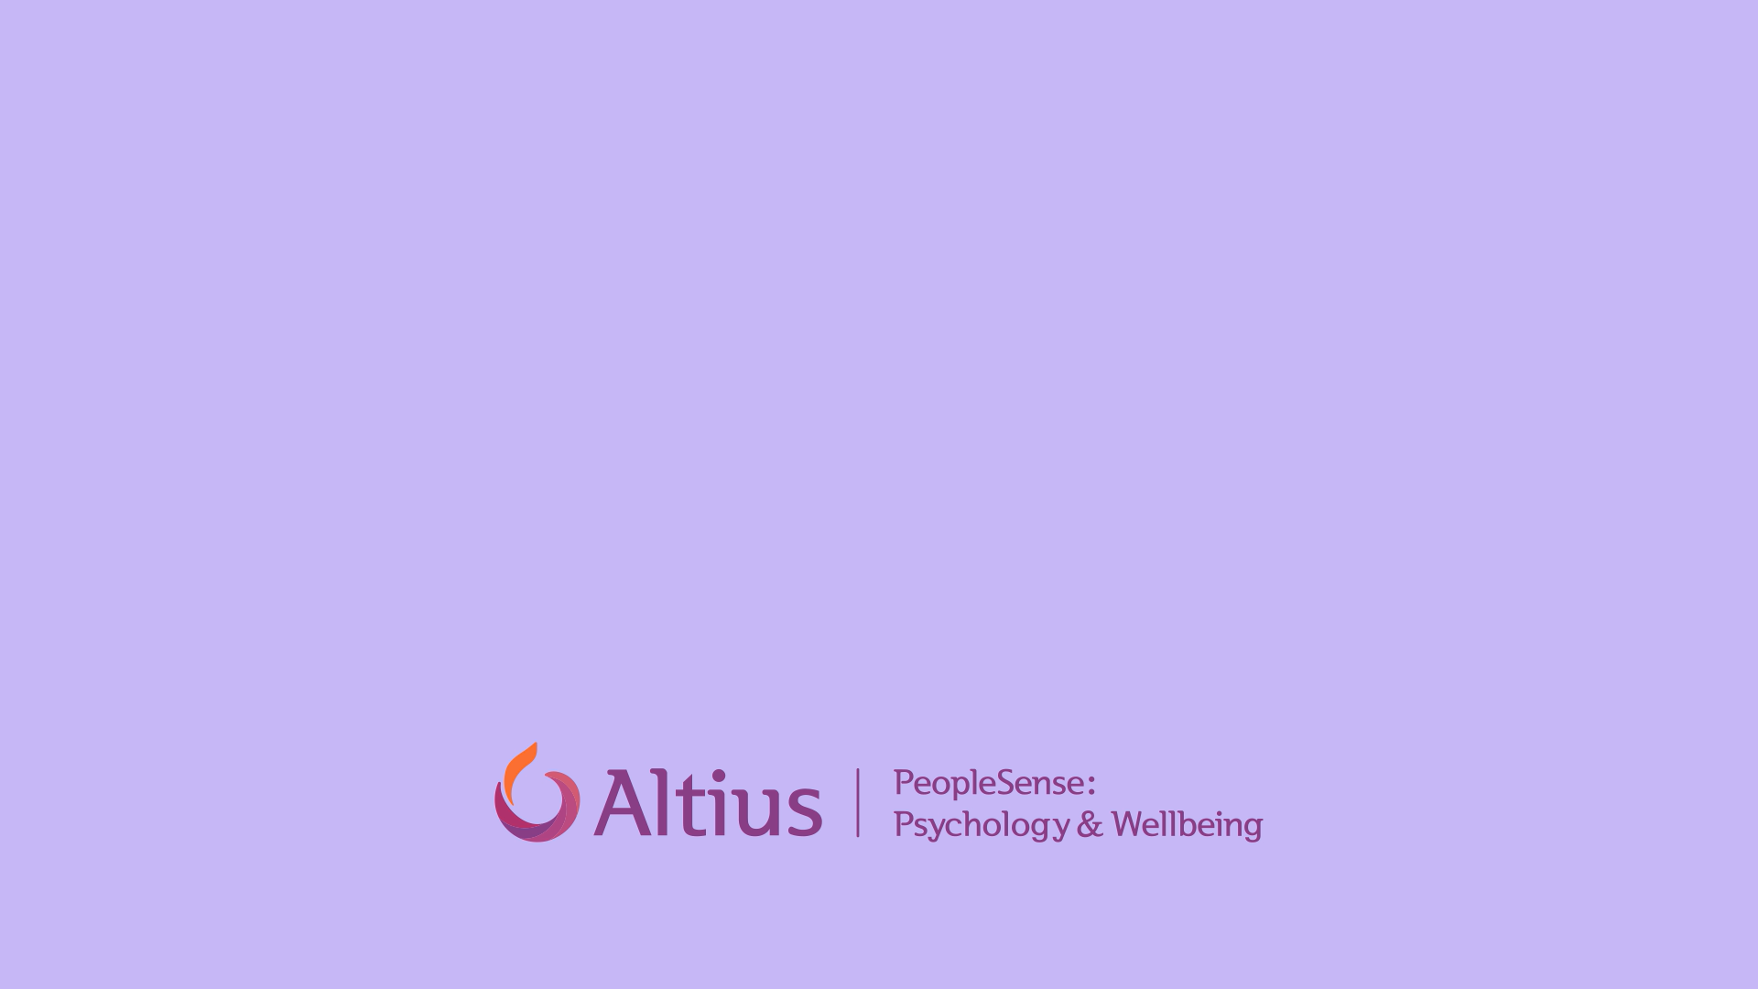
Video: Employee Assist (EAP) Explainer for your people

Slide 7
Leaders Reminder
Email Template #3:
MAP Reminder
Email Subject: Reminder: Manager support is available through our EAP
Dear Leaders,
As part of our Employee Assistance Program, you have access to dedicated support through the Manager Assistance Program (MAP). Leadership often means being a trusted point of contact for your team. While many conversations are part of everyday leadership, there are times when it helps to step back and talk through a situation before deciding on the best way forward.
MAP is designed to support you in those moments. Delivered by PeopleSense: Psychology & Wellbeing by Altius, MAP connects you with qualified, independent professionals who can provide guidance on people-related matters, workplace situations, and leadership challenges. You may find MAP helpful when:
      Preparing for a sensitive or difficult conversation
      Managing Team conflict
      Supporting an employee through a challenging time or responding to wellbeing concerns
      Navigating the pressures and complexity of leadership
Often this aren’t always crisis situations, they are everyday leadership moments where having a sounding board can help you feel more confident and supported in your approach.
Sessions are available by phone, video, or in person, depending on what works best for you.
✅ Free to access ✅ Completely confidential ✅ Available when you need it
How to access the MAP:
Visit: [Insert your PeopleSense booking link]
Registration code: [Insert code]
You can also watch a short video explaining how PeopleSense’s MAP works. Using MAP is a proactive way to support both yourself and your team; please feel encouraged to use it whenever you need.
Kind regards,
[HR Leader Name]
This email reminds leaders that dedicated manager support is available through your existing Employee Assistance Program via the Manager Assistance Program, or MAP.
Copy and paste the content into an email to share with your leaders, managers and supervisors.
Attach the Manager Assistance Program brochure, available via your AltiusLife admin portal, which includes your organisation’s unique registration code for online booking.
Insert your organisations unique Appointment Booking Link and Registration Code where highlighted in the email.
Download the email signature banner from AltiusLife, with your organisation’s unique QR code automatically embedded. Once downloaded, simply add it to your email signature.
No AltiusLife portal access? please email info@altiuslife.com.au
Email signature banner

Slide 8
Video: Manager Assist (MAP) Explainer for your leaders

Slide 9
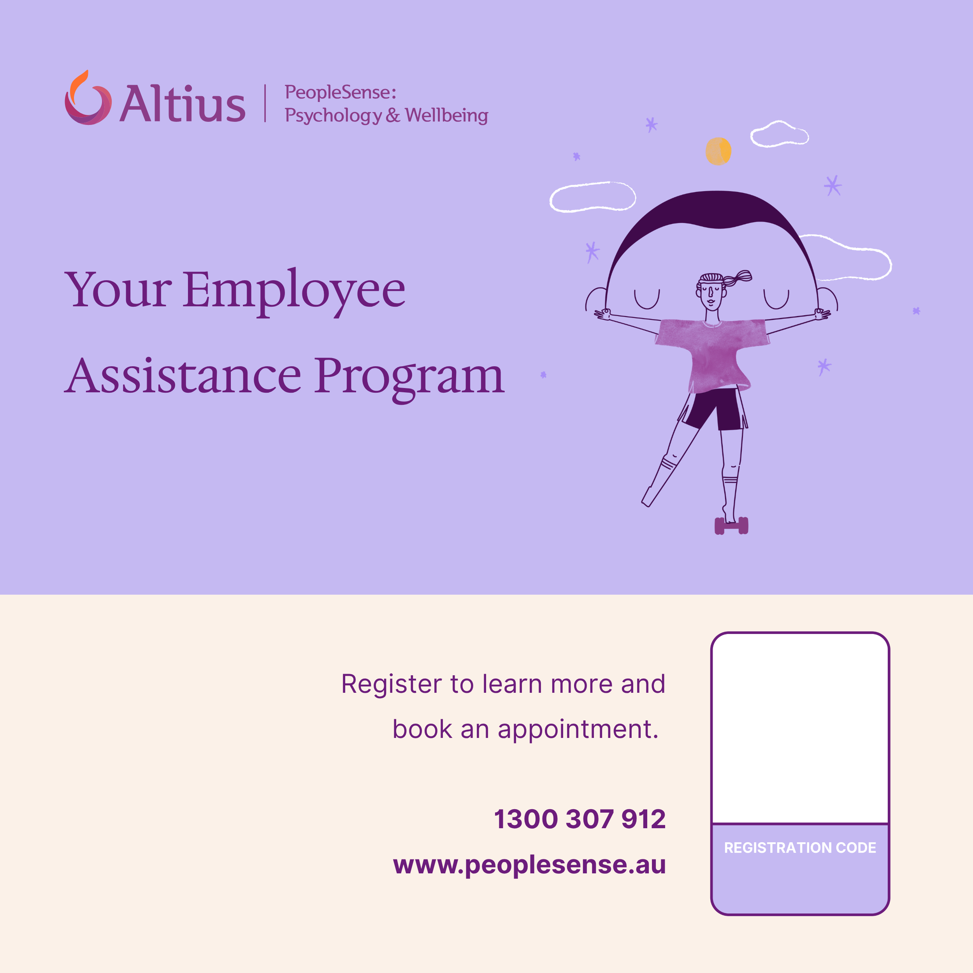
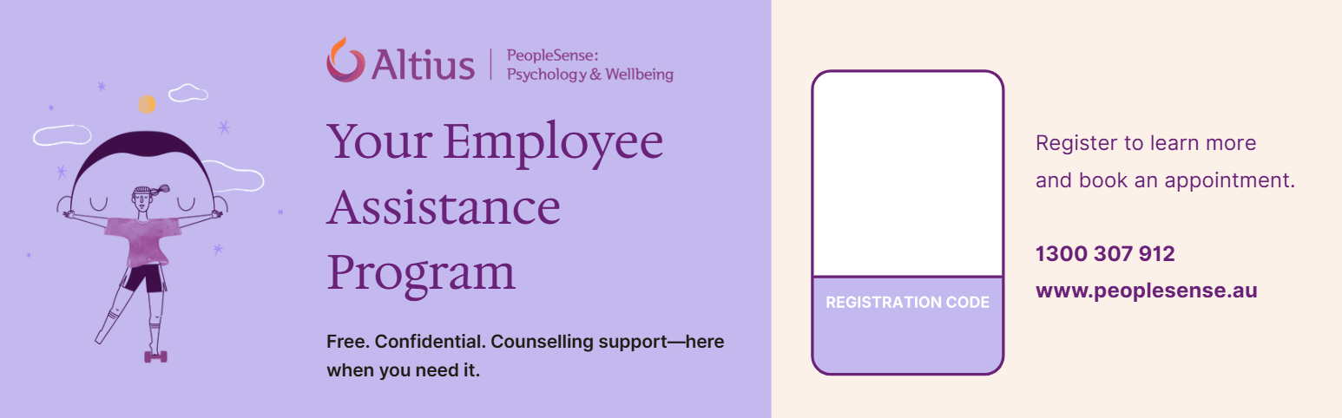
Reminders - All Team Members
Internal social posts and assets
Intranet / Social post Assets
Suggested wording
Use these internal social posts to reinforce the launch messaging and share them across relevant platforms.
These banners can be downloaded for your organisation via the AltiusLife Admin portal. If you do not have access, please email info@altiuslife.com.au
Once logged in, your organisation’s unique registration code will be automatically embedded in the banner. After downloading it from AltiusLife, simply upload it to your intranet.
INTERNAL SOCIAL POST HEADLINE:
Our EAP is here when you need it
A reminder that our Employee Assistance Program, delivered by PeopleSense: Psychology & Wellbeing by Altius, gives you access to free, confidential support from qualified psychologists.
PeopleSense have created a short video to walk you through how PeopleSense EAP works.
You can use our EAP for work or personal matters, including stress, relationships, family pressures, grief, confidence, change, wellbeing, or simply needing someone independent to talk things through with.
Support is confidential and available by phone, video call or in person.
To make a booking, visit [Insert your PeopleSense booking link]
and use our organisation’s unique code: [Insert registration code]
To learn more about your EAP, visit: peoplesense.altius.au

Slide 10
Altius delivers a series of paid and free wellbeing webinars throughout the year to support the mental, physical and emotional health of your employees.
This section provides content to help you promote the free webinars within your organisation.
If you’re interested in accessing the full wellbeing service, please email us at webinars@altius-group.com.au
Wellbeing Webinars

Slide 11








Wellbeing Calendar Invites
Energise Your Life:
International Women's Day
Next Level Finance:
Men’s Health Week
Balancing the Load:
Beyond Tough
The Dynamic Duo of Sleep and Exercise
Practical Steps to Grow Your Wealth
Beyond Tough:
Wellbeing, Equality & Thriving Together
Men’s Wellbeing
in Focus
Thursday, 5 February 2026
2:00pm AEDT / 11:00am AWST
Thursday, 12 March 2026
2:00pm AEDT / 11:00am AWST
Thursday, 7 May 2026
2:00pm AEDT / 11:00am AWST
Thursday, 11 June 2026
2:00pm AEST / 12:00pm AWST
PAID
FREE
PAID
FREE
Please see webinar email templates A and B for content when sending email invites for our
FREE R U OK? Day and Navigating AI Webinars.
Breathe Easier:
R U OK? Day
Say It So It Lands:
Navigating AI:
Practical Ways to Manage Stress and Anxiety
Depression Awareness
Communicating Clearly in Tough Moments
Prioritising Wellbeing in the Digital Age
Managing Depression with Confidence
Thursday, 23 July 2026
2:00pm AEDT / 11:00am AWST
Thursday, 10 September 2026
2:00pm AEST / 12:00pm AWST
Thursday, 22 October 2026
2:00pm AEDT / 11:00am AWST
Thursday, 3 December 2026
2:00pm AEDT / 11:00am AWST
PAID
FREE
PAID
FREE

Slide 12
Webinar Email Template A: RU OK? Day FREE Webinar: Managing Depression with Confidence
Webinar Email Template B: Navigating AI
Email Subject: Join our FREE RU OK? Day webinar to learn how to manage depression with confidence.
Subject: Join our FREE Webinar on Navigating AI for your Wellbeing
Hi Team,
Whether you're supporting a loved one, or managing your own mental health, it can be challenging when you are lost and alone on your journey. We invite you to join our RU OK? Day webinar to gain insights into the intricate brain processes linked to depression and acquire vital skills for fighting stigmas and fostering open, empathetic conversations.
The webinar will explore effective coping strategies and self-care techniques to help people with depression on their path to recovery, while delving into a variety of treatment options including therapy, medication and lifestyle adjustments.
RU OK? Day Depression Awareness:
Managing Depression with Confidence
Hosted by our partners at PeopleSense: Psychology & Wellbeing by Altius
Thursday, 10 September at 2pm AEST / 12pm AWST
Kind regards,
[HR Leader Name]
Hi Team,
Alongside the advantages AI brings, these advancements also bring challenges ranging from technology fatigue and heightened workplace stress to feelings of uncertainty as we adjust to rapid workplace change.
We invite you to join our next FREE webinar which focuses on proactive strategies to manage fatigue, reduce stress and foster a supportive environment that promotes mental health and resilience in the face of such change.
Navigating AI: Prioritising Wellbeing in the Digital Age
Hosted by PeopleSense: Psychology & Wellbeing by Altius
Thursday, 3 December at 2pm AEDT / 11am AWST
Kind regards,
[HR Leader Name]
REGISTER NOW
REGISTER NOW

Slide 13
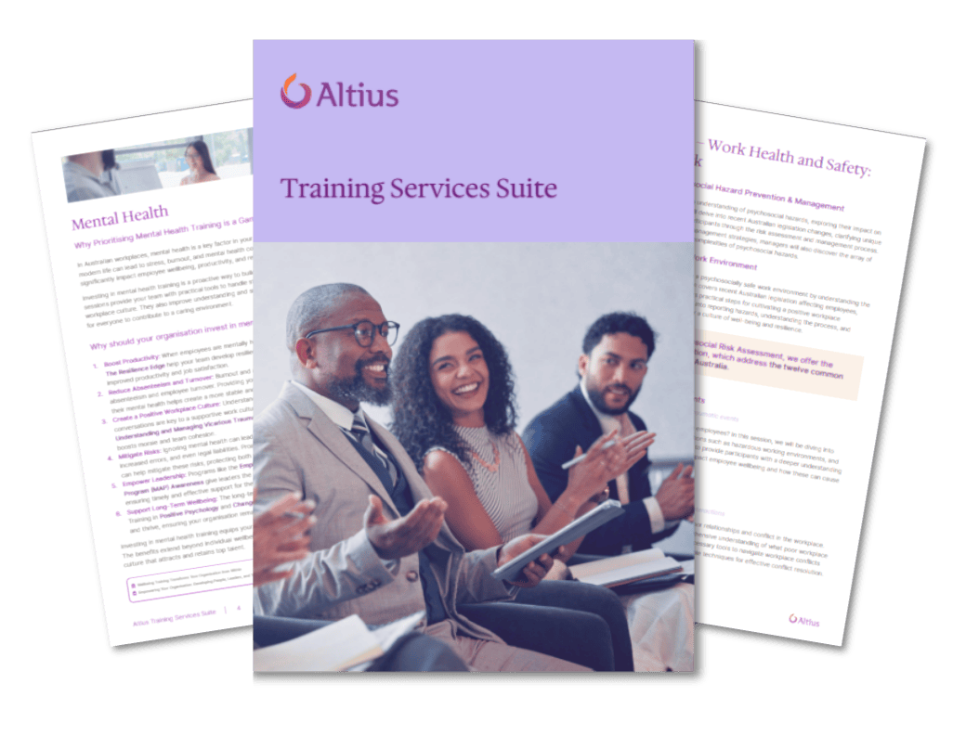

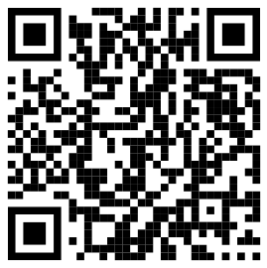
Partner with Altius
Contact us
If you have any questions regarding this pack, please email your account manager directly or send an email to hello@peoplesense.au
Contact Us:
P: 1300 307 912
E: hello@peoplesense.au
W: peoplesense.au
Download our training brochure

Slide 14
Learn More About Altius

Slide 15

Who is Altius
Workplace Health and Wellbeing Solutions That Aim Higher
Too many companies treat employee wellbeing like a box to tick. It’s a mindset that leaves people behind; normalising back pain, burnout, and quiet struggles as part of modern life.
We reject that. Our name, Altius, means “higher.” It’s a call to be better. But aiming higher doesn’t look the same for everyone. Wellbeing is personal. Non-linear. Human. Some are bouncing back from injury. Others are chasing performance or simply trying to feel balanced and supported. Every journey is different.
That’s why we challenge organisations to go beyond compliance; setting bold goals, building flexible systems, and designing for real life.
Always aiming higher. Together.

Slide 16
Altius Wellbeing Spectrum
There’s nothing linear about being human
As Australia's leading integrated workplace health and wellbeing partner, Altius is dedicated to providing truly comprehensive health, wellbeing, safety, and performance support for you and your people, Both physical and psychological. For any role, at any seniority, in any industry, wherever your people are in their wellbeing journey.
Peak
At Risk
Acute
Chronic
For when your people who are healthy and well and looking to push performance. Our services combine cutting edge, science-backed physical and psychological techniques to help your people achieve optimal performance.
Physical and Psychological stress often begins long before the point of injury or illness. Our risk management solutions combine best in class wellbeing, psychological, and workplace health and safety services to not only meet your legislative obligations but also aim for higher levels of wellbeing overall.
When your people do unfortunately suffer physical and/or psychological injury, we are the leaders in not only ensuring full and successful recovery but also supporting them through their return to the workplace to ensure it’s a sustained return to wellbeing rather than simply a return to work.
We offer a comprehensive suite of services to support anyone who suffers a severe or complex injury. From clinical physical and psychological treatment, to return to Work assessments, adaptations and support - with you or a new employer - we have your people covered.

Slide 17
Altius Wellbeing Spectrum
Service map
Peak
Psychological Health
Flourishing
Physical Health
Fit and pain free
Employee Assistance Programs (EAP)
Manager Assistance Programs (MAP)
Psychometrics
Wellbeing Programs
Executive Health Assessments
Executive Health Management Programs
Focus
High Performance
At Risk
Psychological Health
Languishing
Employee Assistance
Programs (EAP)
Manager Assistance Programs (MAP)
WHS Audits & Assessments
WHS Consultancy & Secondments
WHS Training
Psychosocial Risk Management
Outsourced Return to Work (RTW) Co-ordination
Physical Health
Coping/Managing
Psychometrics
Executive Health Assessments
Manual Task Training
Critical Incident Response (CIR)
Pre-employment Screening
Ergonomics
Psychological Counselling & Assessments
Focus
Early Intervention
Organisational Psychology
Mediation & Conflict Resolution
Exercise Physiology
Wellbeing Programs
Welfare Checks
Executive Health Management Programs
Acute
Psychological Health
Struggling
Employee Assistance Programs (EAP)
Manager Assistance Programs (MAP)
Fitness For Work (FFW) Assessments
Critical Incident Response (CIR)
Ergonomics
Mediation & Conflict Resolution
Psychological Counselling & Assessments
Physical Health
Acute Injury
Welfare Checks
Exercise Physiology
Executive Health Management Programs
Functional Capacity Assessments (FCA)
Occupational Rehabilitation
Focus
Return to Work
Chronic
Psychological Health
Floundering
Physical Health
Chronic Injury
Fitness For Work (FFW) Assessments
Exercise Physiology
Occupational Rehabilitation
Functional Capacity Assessments (FCA)
Psychological Counselling & Assessments
Focus
Managing Long Term /
Permanent Absence

Slide 18

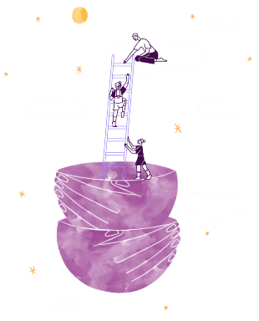

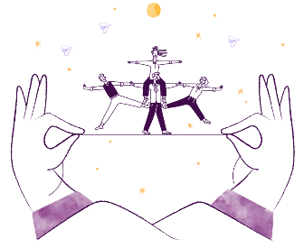
About us
Our Service Pillars
Helping employees achieve mental clarity and resilience by offering more than basic support. Altius inspires people to aim higher in their emotional, physical, and psychological health, empowering them to thrive, not just cope.
Enabling leaders to perform at their peak by addressing stress and enhancing their capacity for high performance. Altius encourages executives to exceed their limits and set new standards for leadership excellence.
Going beyond traditional recovery processes to help employees regain not just their health but also their confidence and full potential. Altius focuses on empowering individuals to emerge stronger and better equipped for the challenges ahead.
Elevating safety from mere compliance to a culture of proactive prevention and wellbeing. Altius equips workplaces to foster environments where employees feel secure and supported, enabling them to perform at their best.

Slide 19
Partner with Altius
Together we set the standards for corporate health & wellbeing services
One dedicated partner
Technology enhanced insight
Trusted by Australia's leading companies, across multiple industries
Altius and our Altius Wellbeing Spectrum unifies health, safety and performance under a single brand, mapping every physical and psychological need for any role, seniority or industry.
Market leading digital innovation and proprietary IP free our clinicians to focus on care while giving you real time, actionable ROI.
900+ multidisciplinary experts
Nationwide reach
Psychologists, physicians, rehabilitation and WHS specialists collaborating to deliver integrated support.
90 locations and telehealth support ensure consistent assistance wherever your people work.

Slide 20

Thank You!

